Slide 1


























GSA Grasshopper Plugin
Dim
Annotation text
1
Highlight something
2
Highlight something
SSN.E - Parametric Design for Structures
10th February 2021
Kristjan Nielsen

Slide 2
Overview
Workflow and Apps EcoSystem

Slide 3
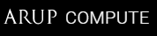

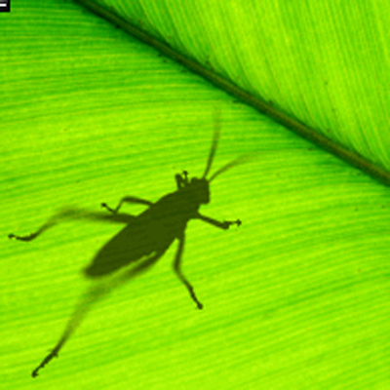



ArupCompute
DesignCheck
Rhino
Grasshopper
Total Design Automation
GSA Grasshopper
Speckle
Speckle Server
GsaAPI
Headless GSA
GSA
AdSec
Local computer
Cloud
Overview Workflow and Eco system of connected applications

Slide 4

Installing Plugin
Rhino Package Manager

Slide 5
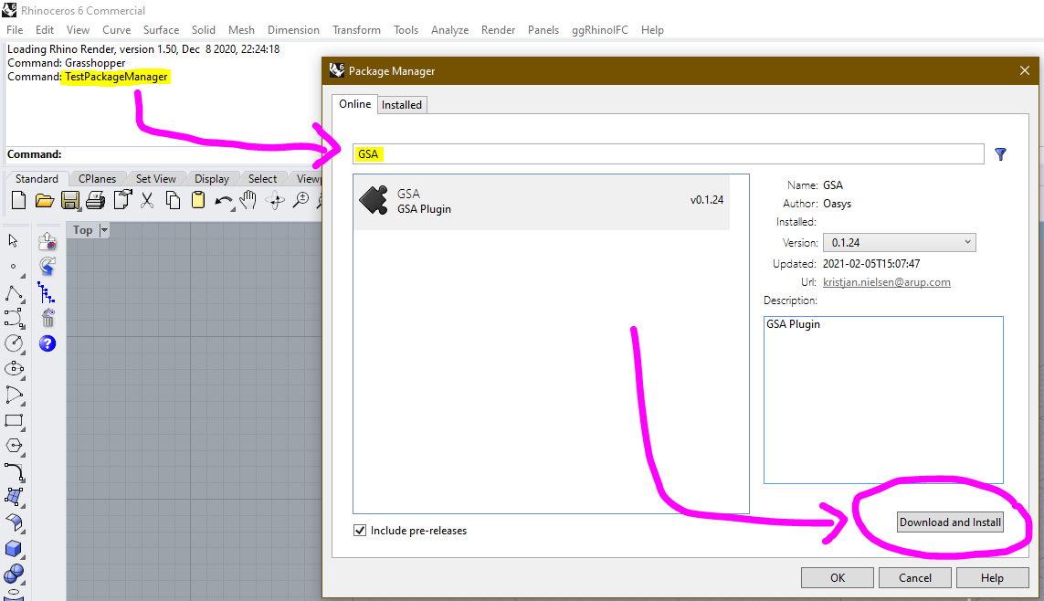
1
2
Rhino Command:
TestPackageManager
3
Installing GSA-Grasshopper

Slide 6
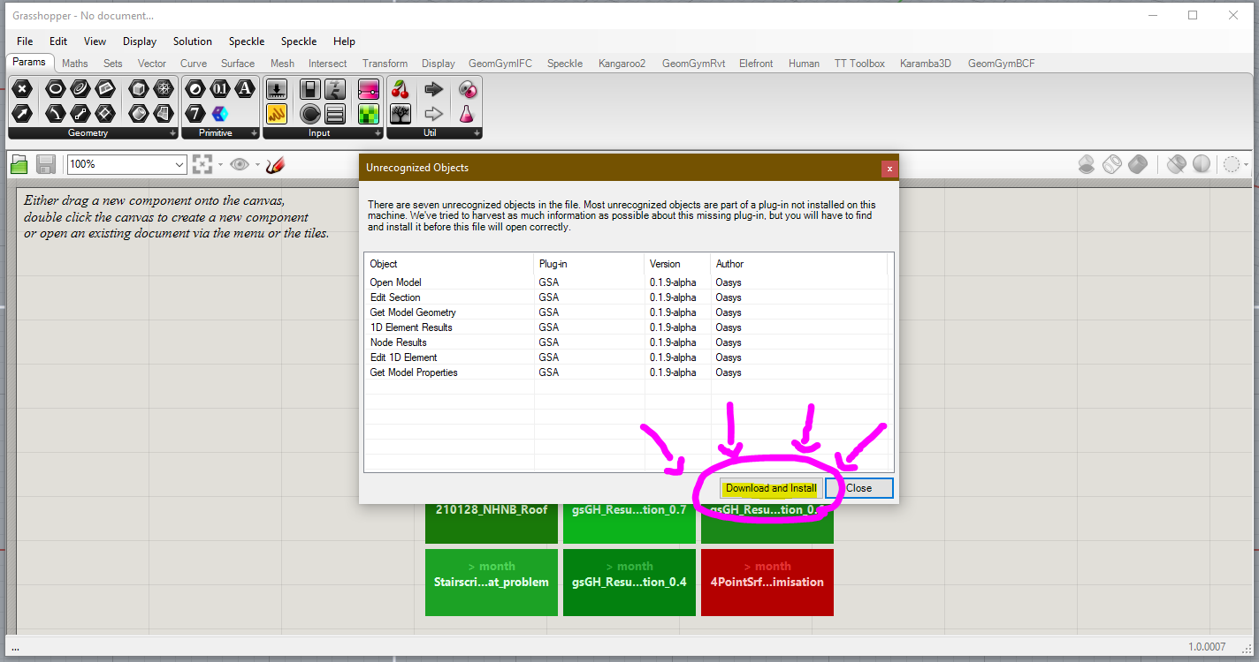
Installing GSA-Grasshopper

Slide 7
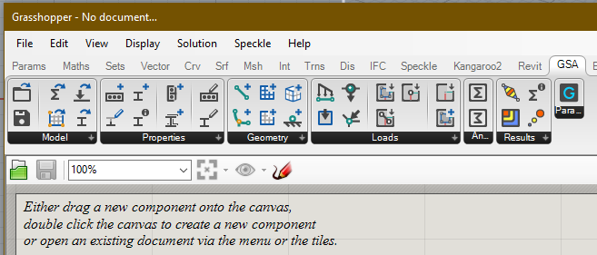
Overview
Plugin Sub-Categories

Slide 8









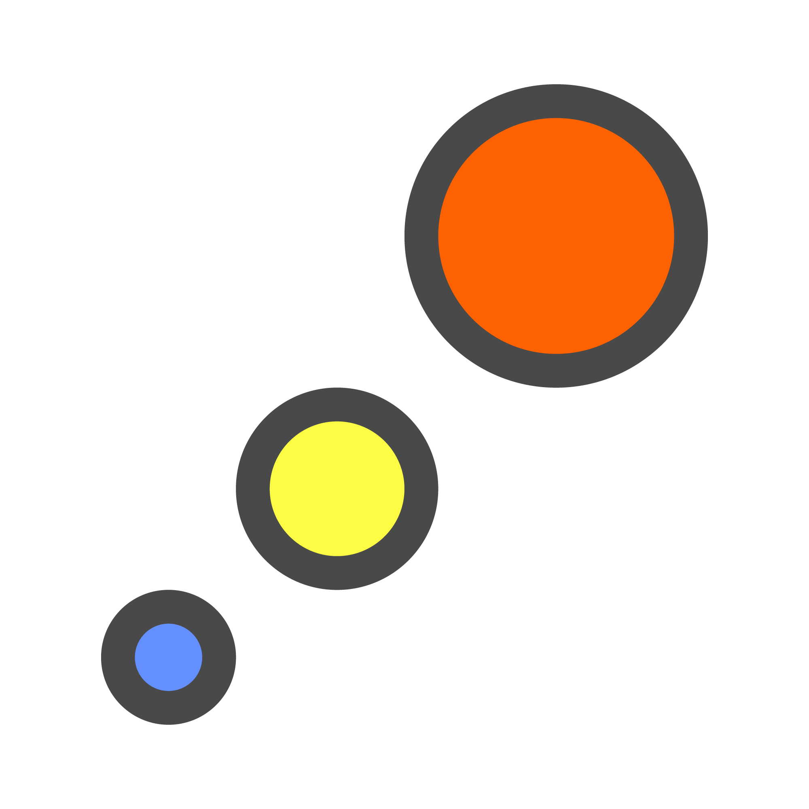



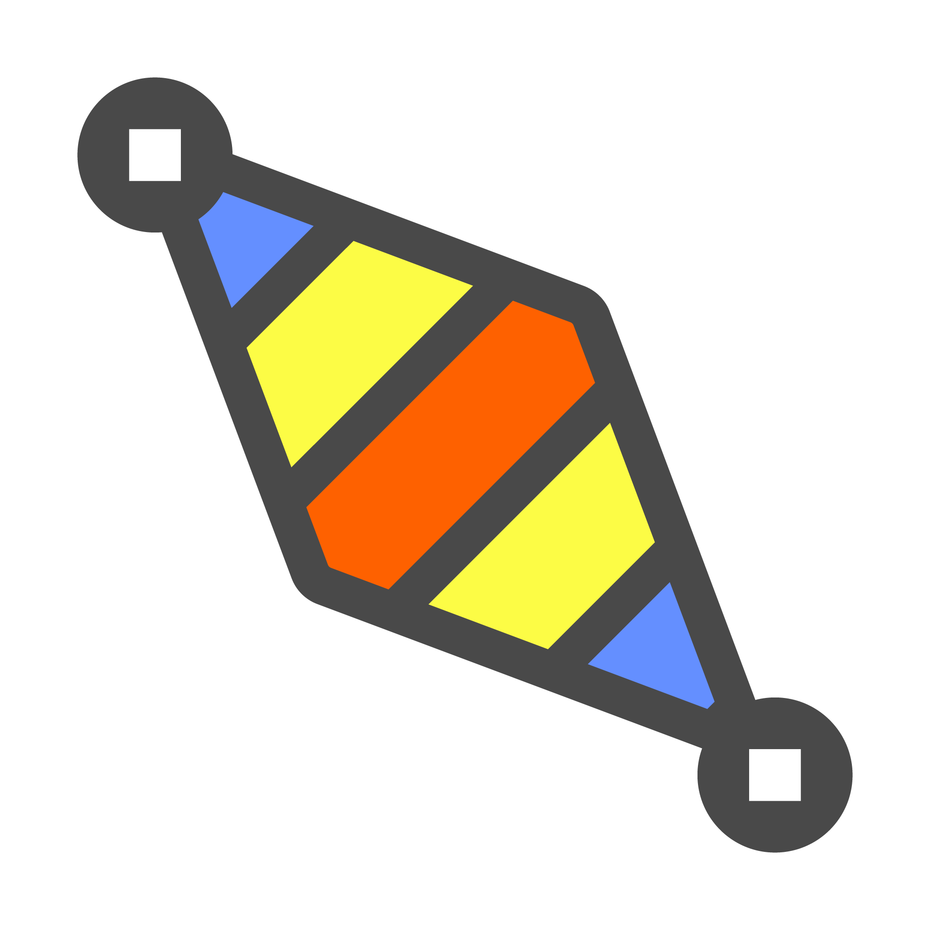






Model
GSA Model
GSA Model
Open Model
Save Model
Properties
Section
Prop2D
Offset
Spring
Bool6
Geometry
Node
Element1D
Element2D
Member1D
Member2D
Member3D
Loads
Load
GridPlnSrf
Node Res.
1D Results
2D Results
Analyse
Results
Overview Plugin workflow

Slide 9
Model
GSA Model
GSA Model
Open Model
Save Model
Properties
Section
Prop2D
Offset
Spring
Bool6
Geometry
Node
Element1D
Element2D
Member1D
Member2D
Member3D
Loads
Load
GridPlnSrf
Node Res.
1D Results
2D Results
Analyse
Results
Overview Plugin workflow

Slide 10
Model

Slide 11
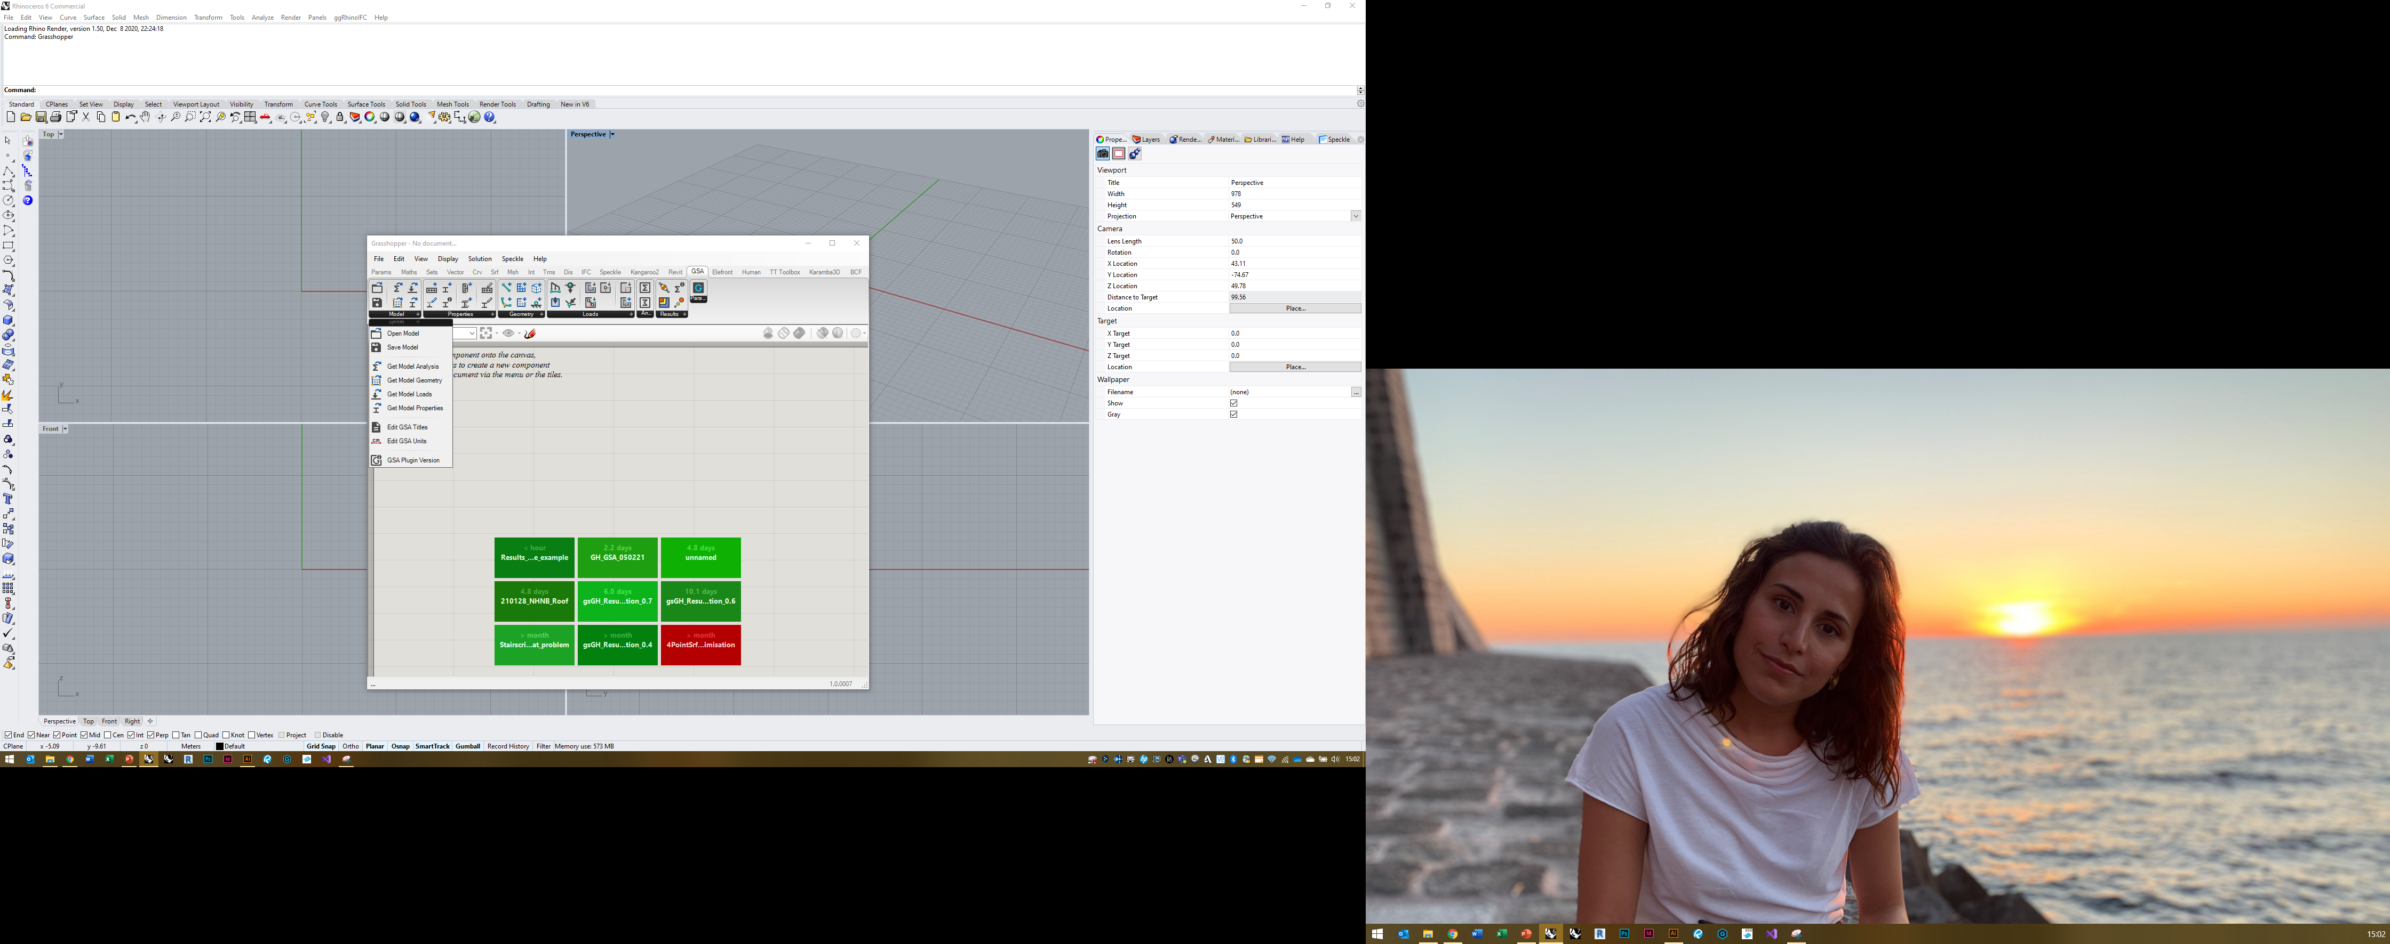
Model tab

Slide 12
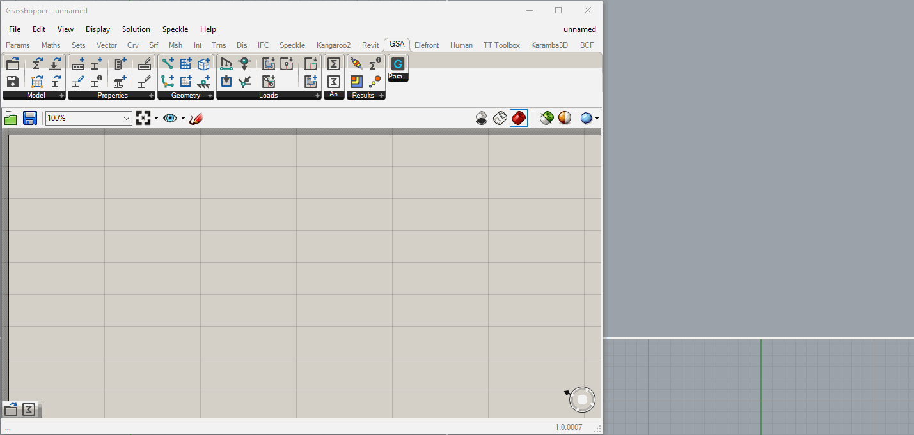
Open Model & Get Geometry

Slide 13
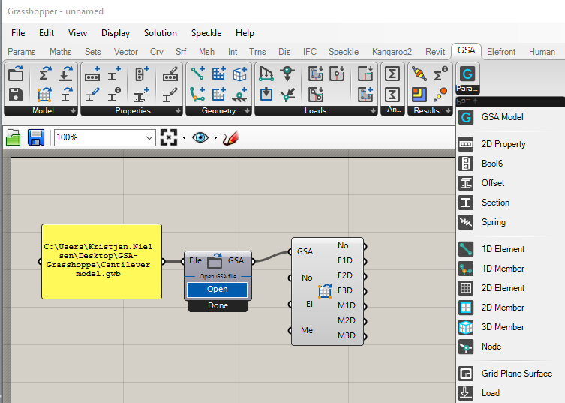
GSA Grasshopper Parameters

Slide 14
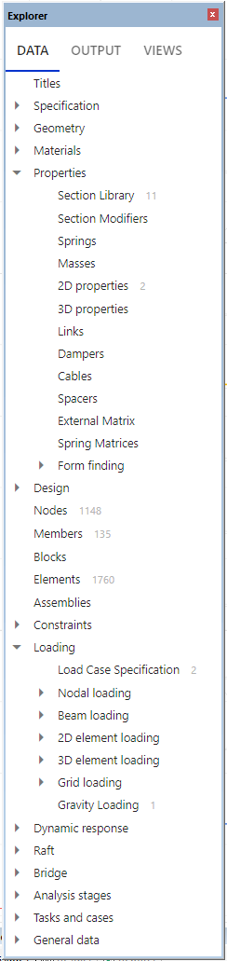
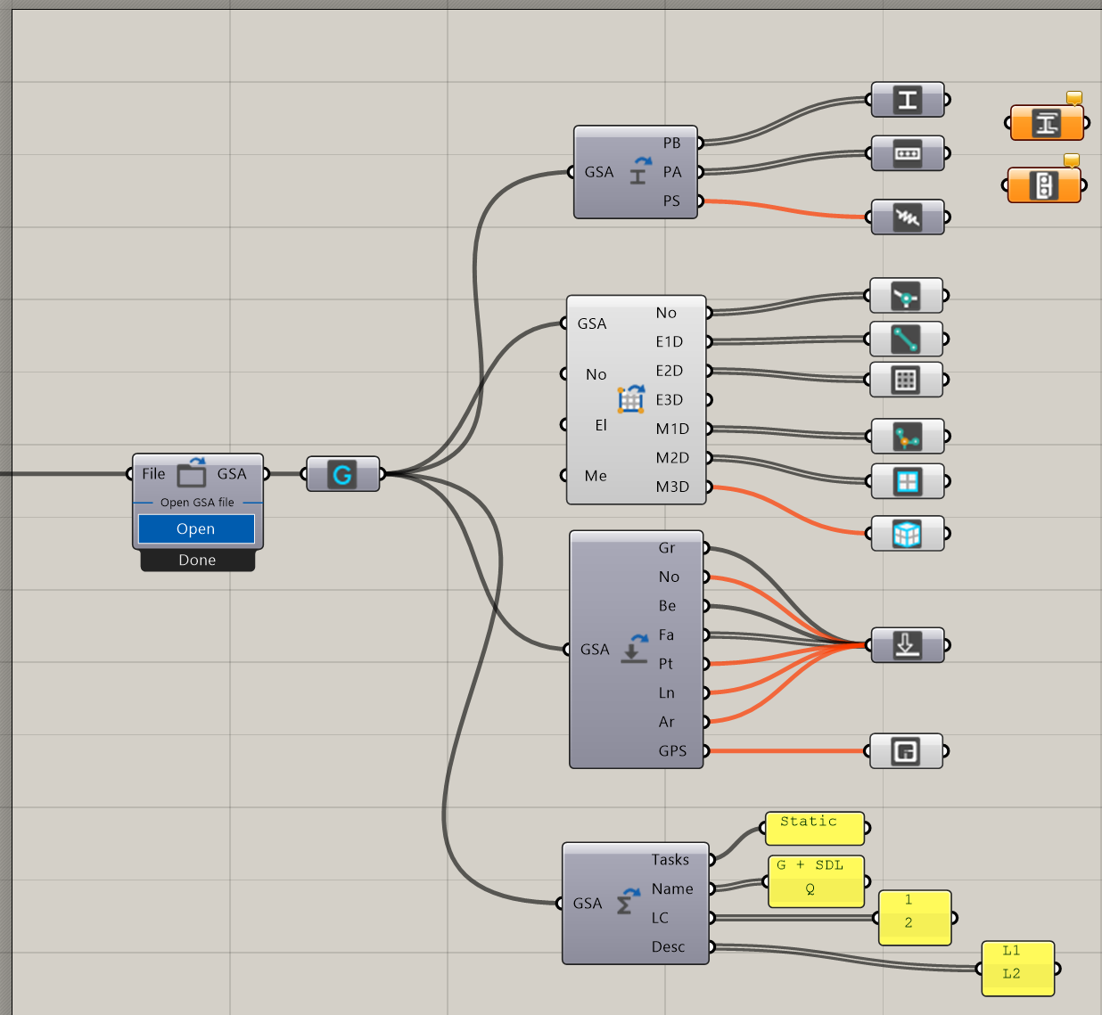
GSA Grasshopper Parameters – GSA Reference

Slide 15
Properties

Slide 16
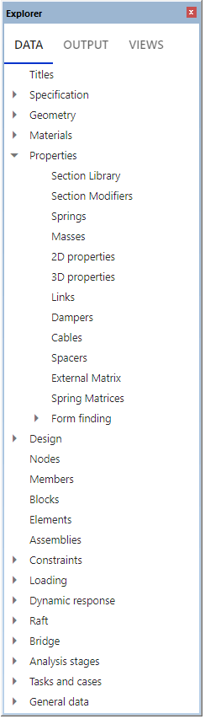
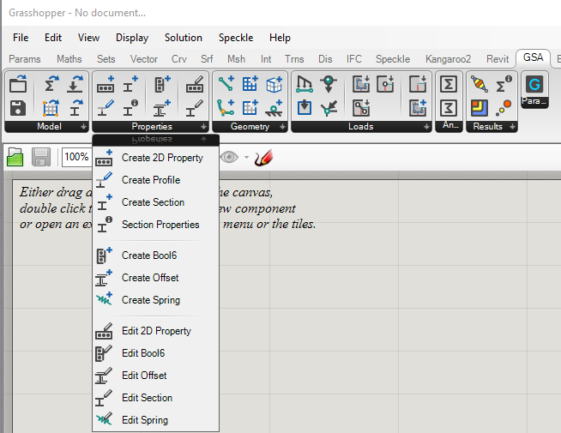
Properties tab

Slide 17
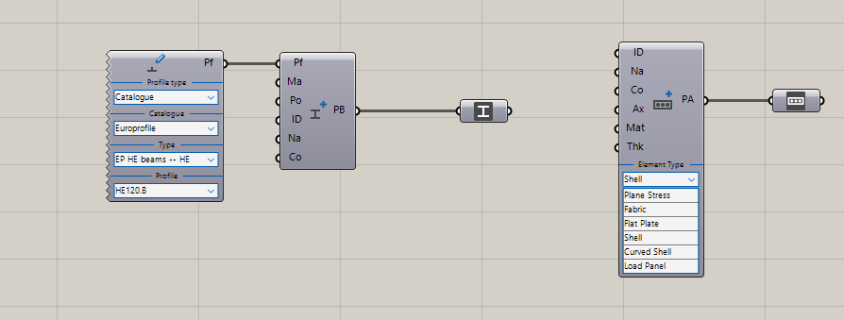
Create Properties Examples [Live Demo]

Slide 18
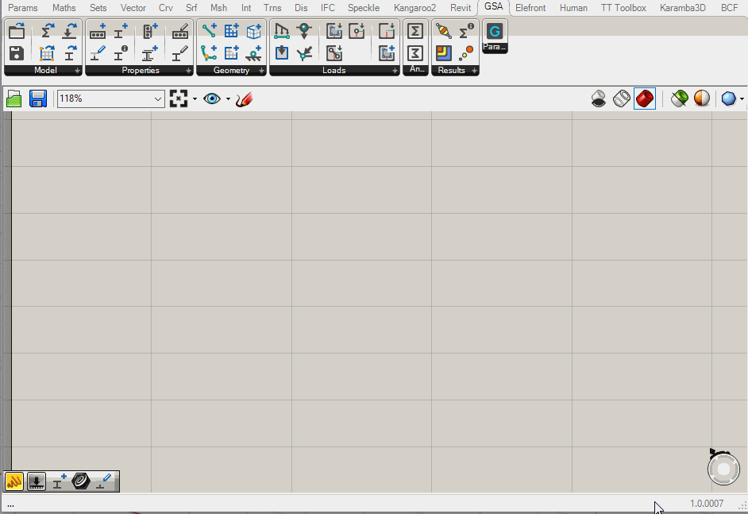
Create Profile

Slide 19
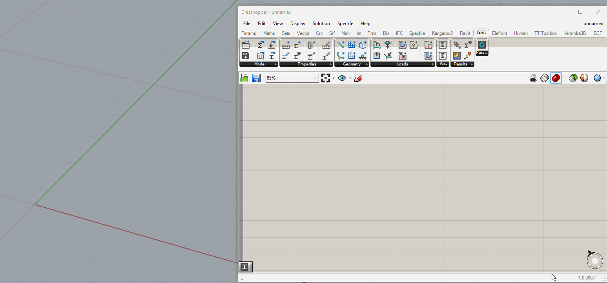
Create Geometric Section

Slide 20
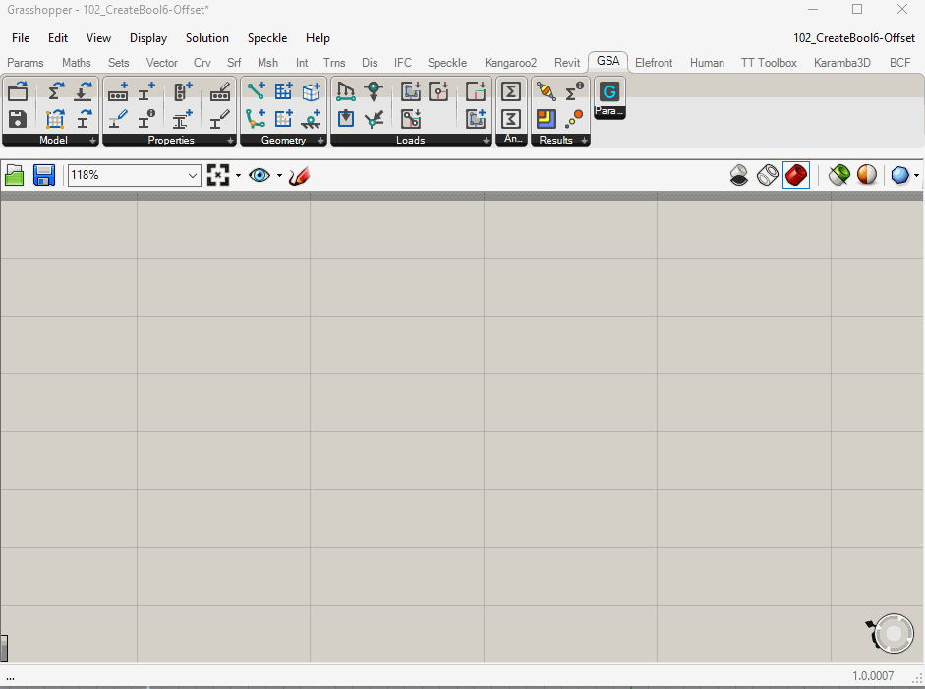
Create and Edit Bool6 Parameter

Slide 21
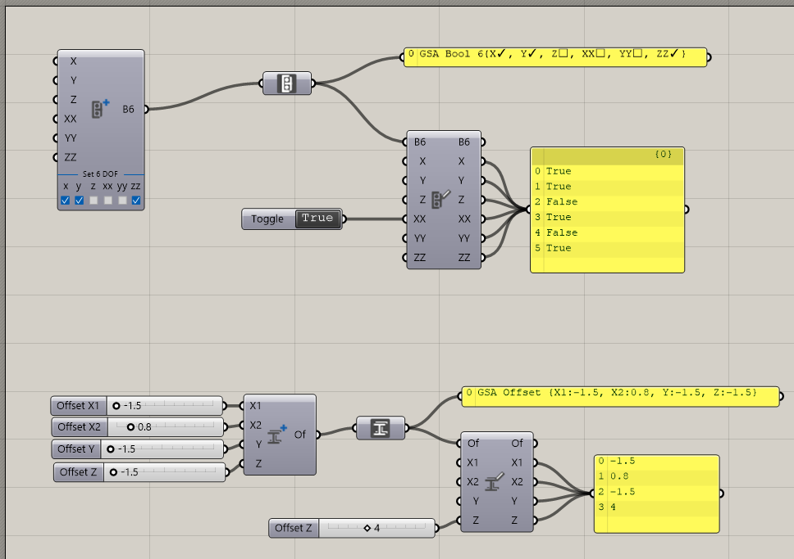
Bool6 and Offset Properties

Slide 22
Geometry

Slide 23
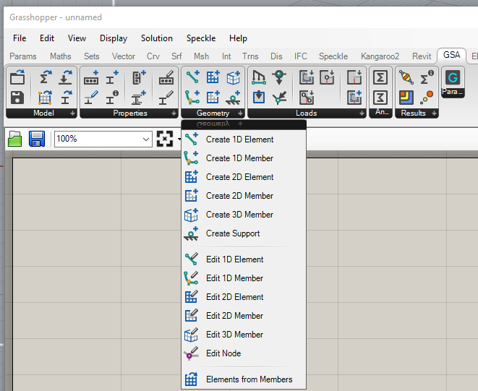
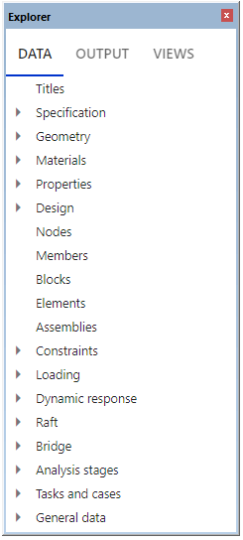
Geometry tab

Slide 24

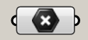

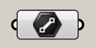

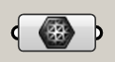

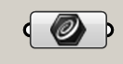

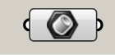

0D
Node
Point3D
(x, y, z)
1D
Element1D
Line
(x₁, y₁, z₁, x₂, y₂, z₂)
2D
Element2D
Mesh
(Verticies, FaceList)
1D
Member1D
PolyCurve (Arc or Polyline)
(TopologyList)
Nurbs crv auto-converted to Arc or Polyline
2D
BRep auto-converted to planar
Nurbs edges and incl. Crvs auto-converted to Arcs and Lines
Inclusion Pts and Crvs auto-projected onto plane
Member2D
Planar BRep (Edges, inc.Lines, inc.Pts)
3D
Member3D
Solid (Closed Mesh) (Verticies, FaceList)
BRep auo-capped if not closed
BRep auto-converted to mesh
Rhino/GH Geometry correlation with GSA Geometry

Slide 25
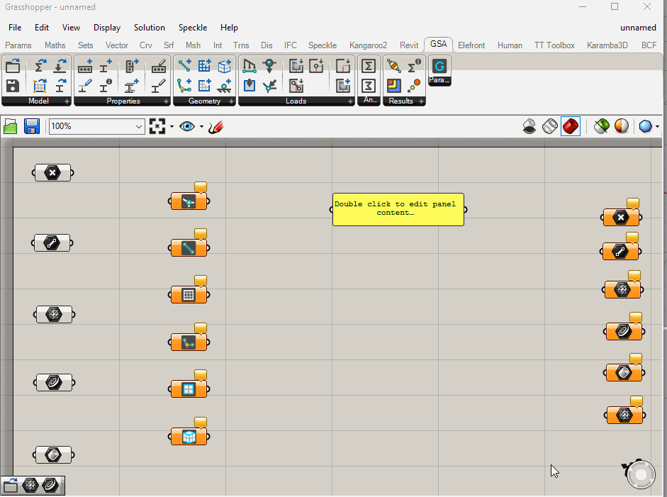
On-the-fly conversions

Slide 26
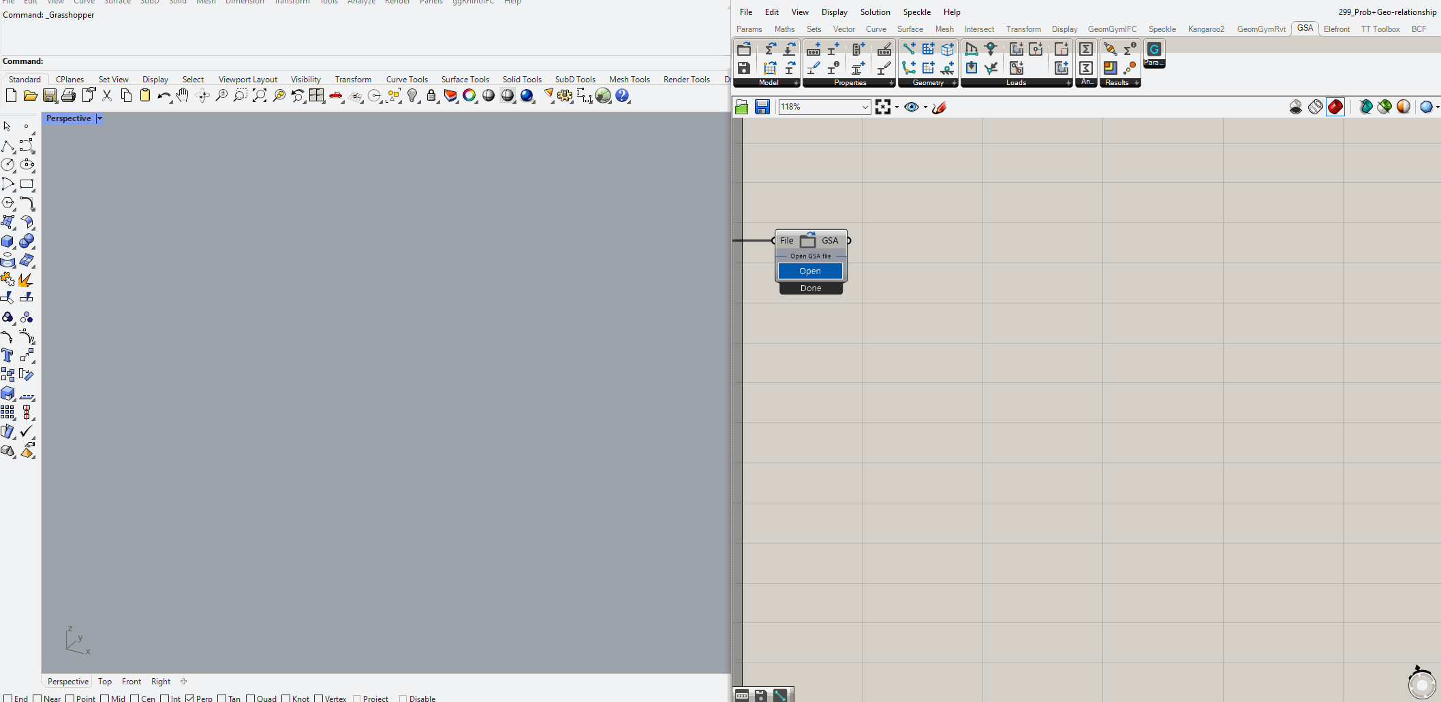
On-the-fly conversions with Existing GSA Model

Slide 27
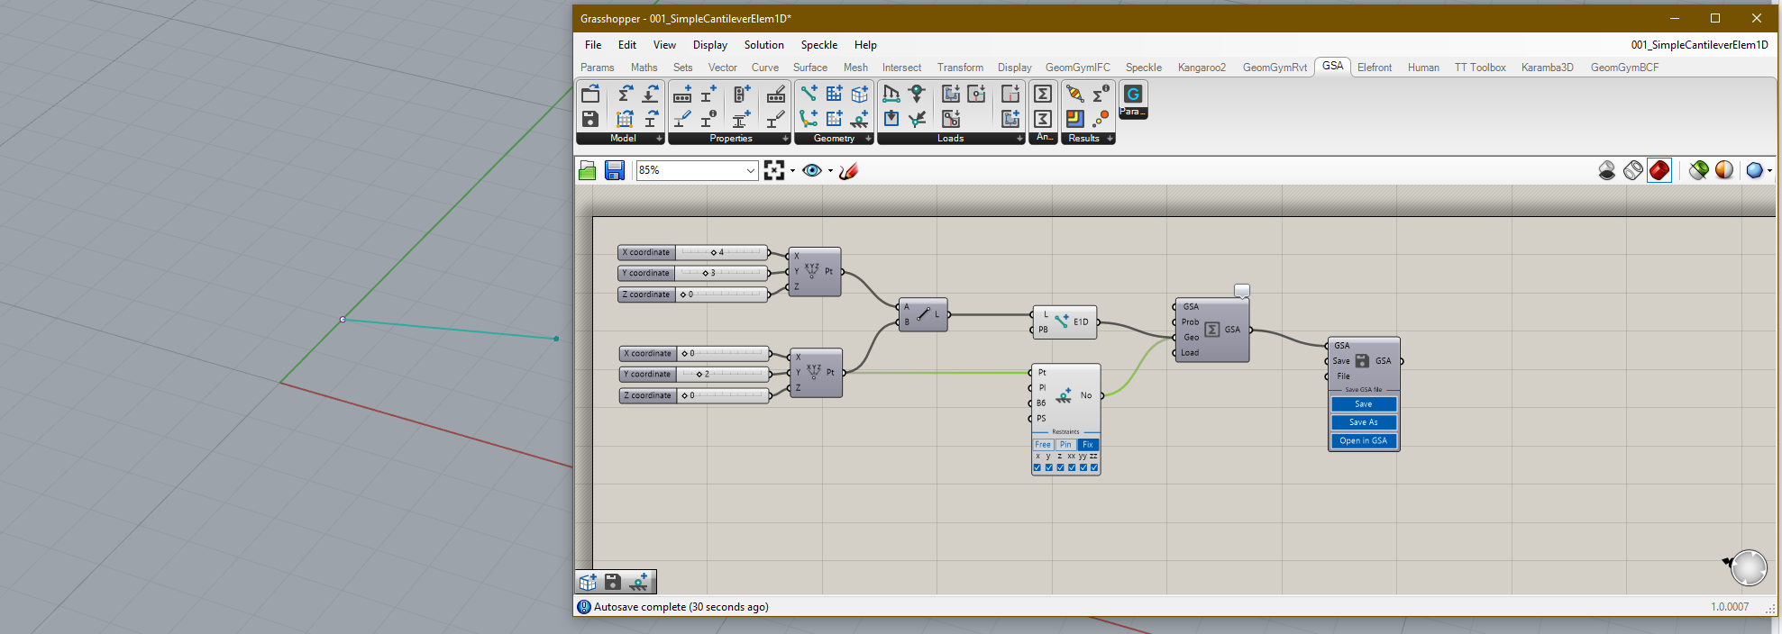
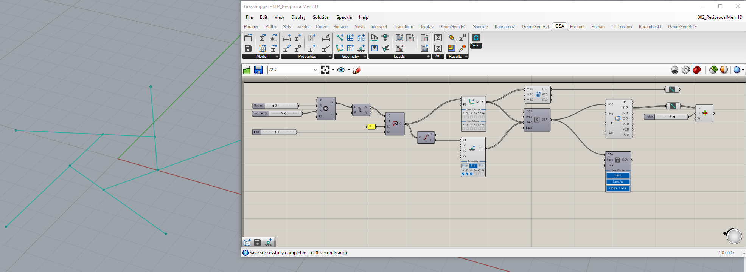
Create Geometry Examples [Live Demo]

Slide 28
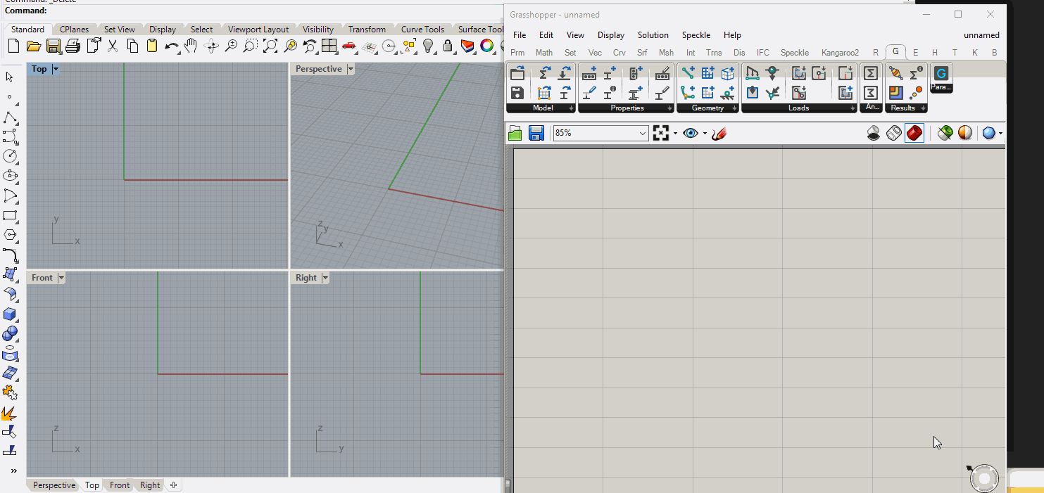
Create Member2D with inclusion Pt and Crv Example

Slide 29
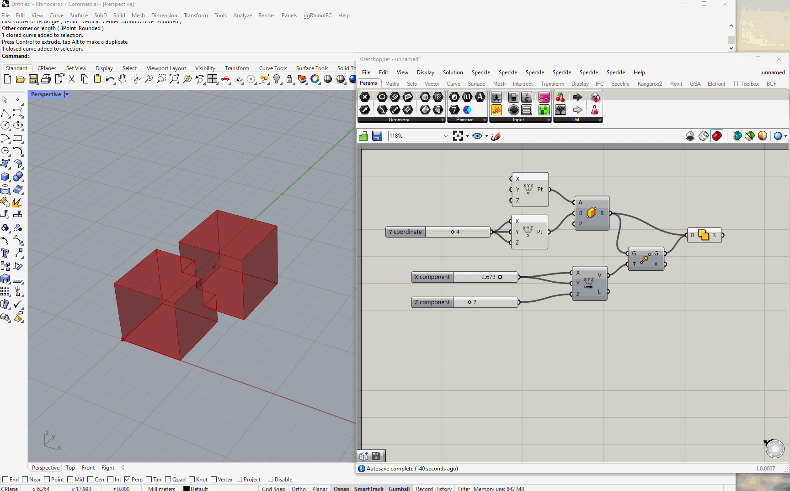
Create Member3D Example

Slide 30
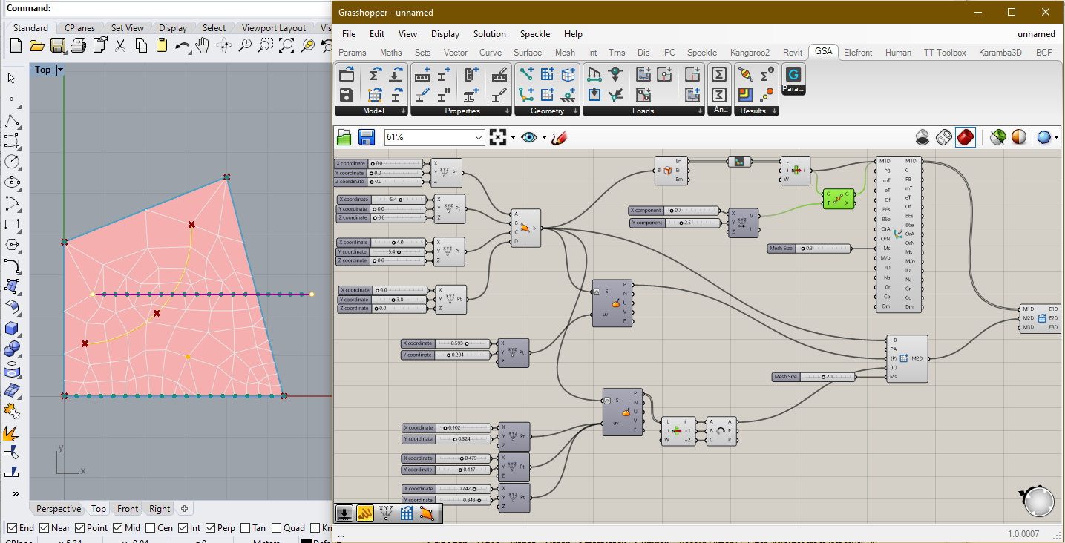
Create and Edit Member1D and Member2D Mesh Size [Live Demo]

Slide 31
Working with IDs

Slide 32
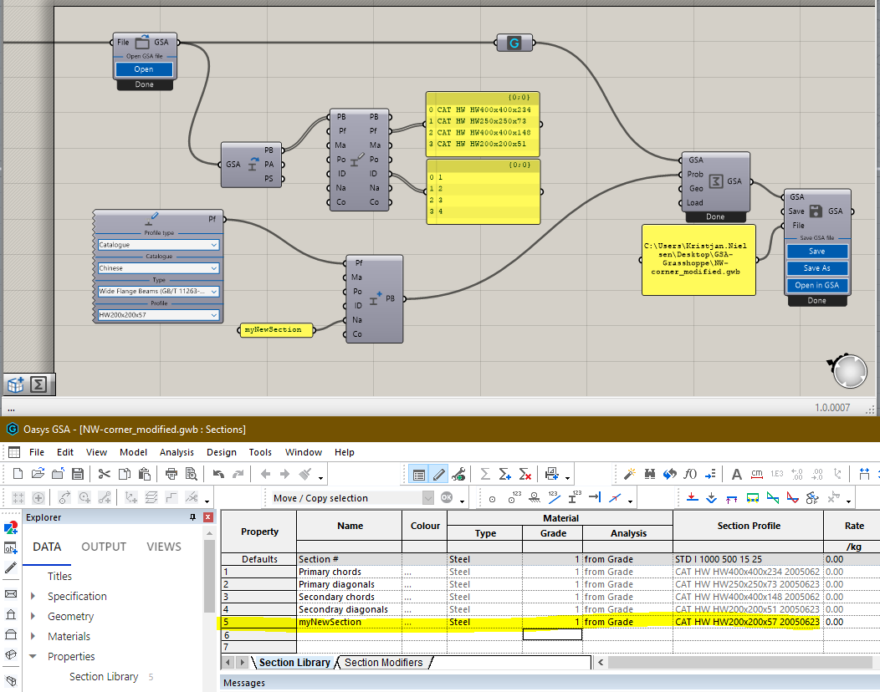
Section Properties in existing GSA Model. The model contains 4 sections
1
Create a new Section without setting the ID
2
3
Combine Existing GSA Model with new Property in Analysis component. Use Save to save the GSA Model with changes
Open the modified GSA Model in GSA. The Section Library now includes the new Section appended to the existing 4
4
Working with IDs – No ID set

Slide 33
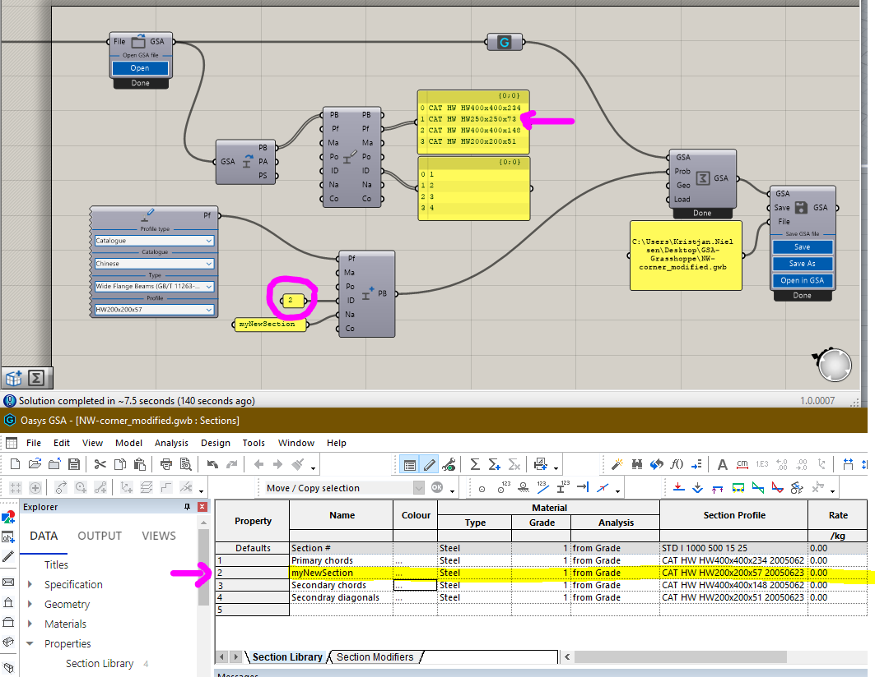
Section Properties in existing GSA Model
1
Set ID to a number bigger than 0 (zero) overwrite existing Property
2
3
Combine Existing GSA Model with new Property in Analysis component. Use Save to save the GSA Model with changes
Open the modified GSA Model in GSA. The old second with ID=2 has been replaced by the new Section
4
Working with IDs – SET ID

Slide 34
Section
Prop2D
Node
Element1D
Element2D
Member1D
Member2D
Member3D
Geometry
GridPlnSrf
Properties
Loads
GSA Grasshopper GridPlaneSurface has ID for both GridPlane and GridSurface, but not for Axis
Also note that Loads does not have ID and will thus always be appended
Working with IDs – GSA Parameters with IDs

Slide 35
Properties and Geometry
Relationship between Section/Prop2D and Elements/Members

Slide 36
Properties
Geometry
Element1D
1D
Section
Member1D
Element2D
Prop2D
2D
Member2D
Overview relationship Section/Prop2D with Elements/Members

Slide 37
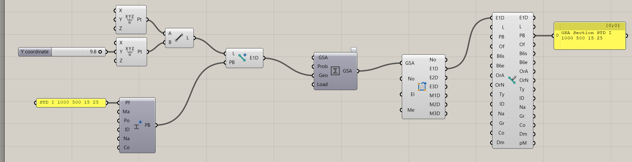
Create new Element1D from Line and input PB to attach this section to the Element1D object. The Element1D object will carry the Section with it around the GH script
2
3
1
Create new Section without ID (ID = 0). Section will be appended to end of existing Section Library
Assembling the model using Analysis Component can be done without inputting Section in “Prop”
Workflow Example 1

Slide 38
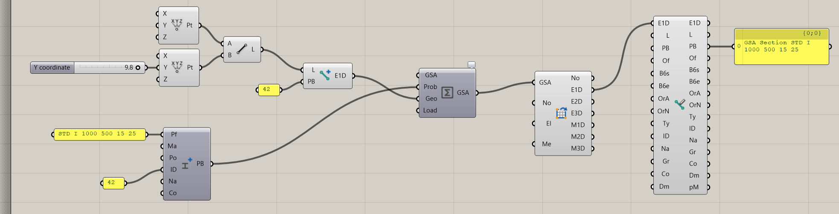
Create new Element1D from Line and input Integer (42 here) in PB-input to make reference to a Section number in the Section Library. Section may already exist in a GSA model and does not need to be created in Grasshopper
2
3
1
Create new Section with unique ID (ID = 42 here). Section will be set (and overwrite existing Section) in Section Library
Assembling the model using Analysis Component should be done with both Prop and Geo inputs, unless Section already exist in an existing GSA model
Workflow Example 2

Slide 39
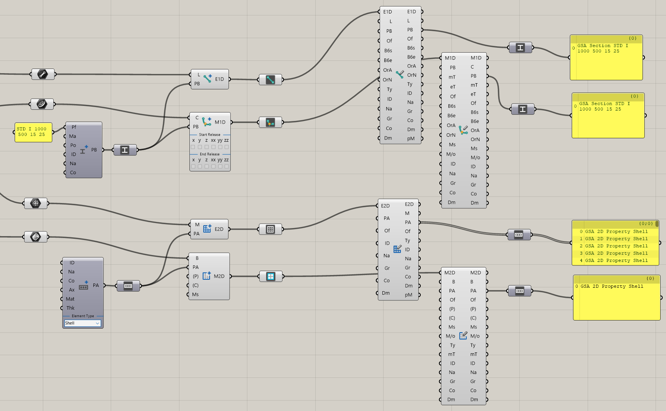
Edit components
Create components
1D
2D
Relationship between Section/Prop2D and Elements/Members

Slide 40
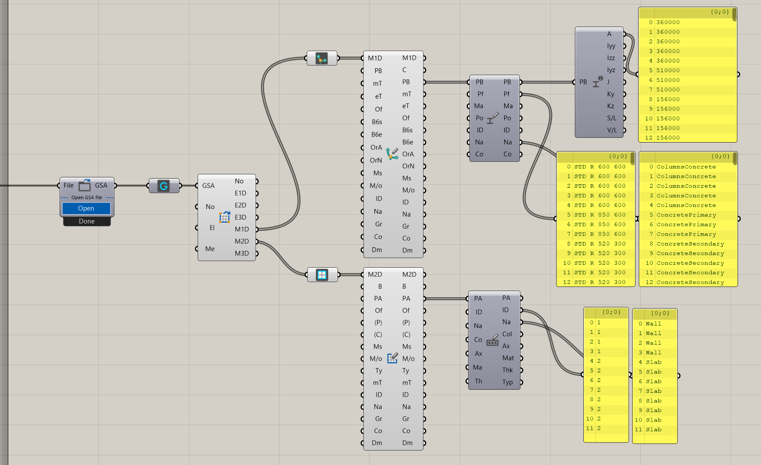
Edit components
SectionProperties
EditMem1D
EditSection
OpenModel
GetGeometry
EditProp2D
EditMem2D
Applies when opening Existing Model as well

Slide 41
Loads
Typical referenced by object

Slide 42
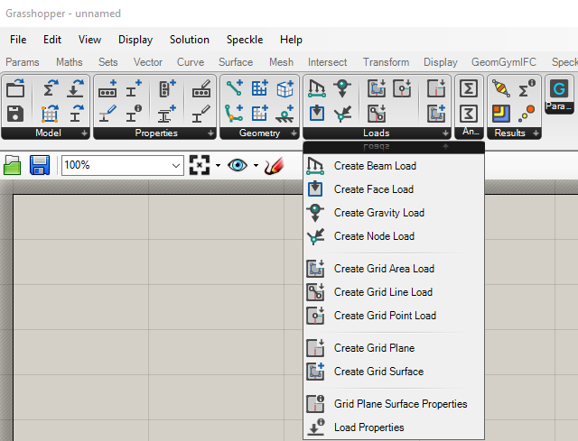
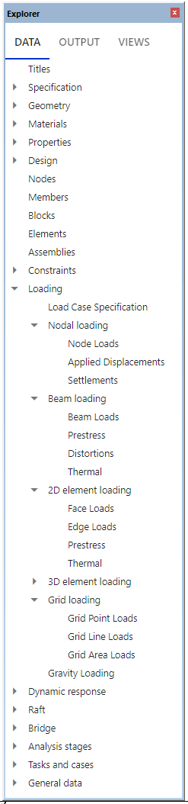
Load tab

Slide 43
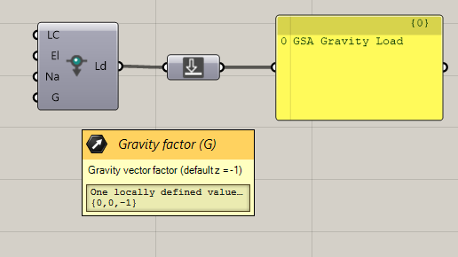

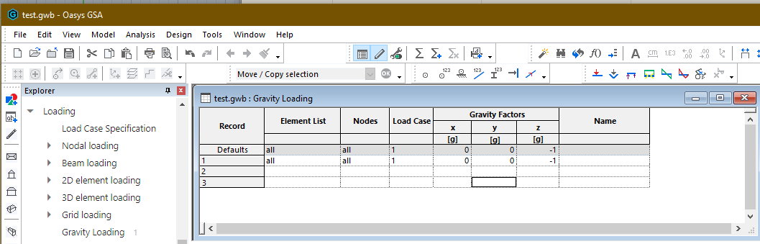
LC default = 1
List of elements default = “All”
Name is optional (default empty)
Gravity vector default = (0, 0, -1)
Typical Loads - Gravity

Slide 44
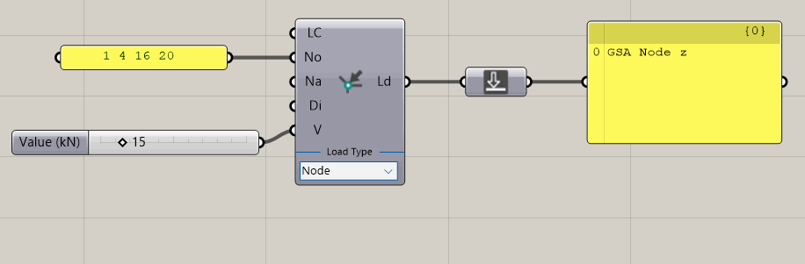
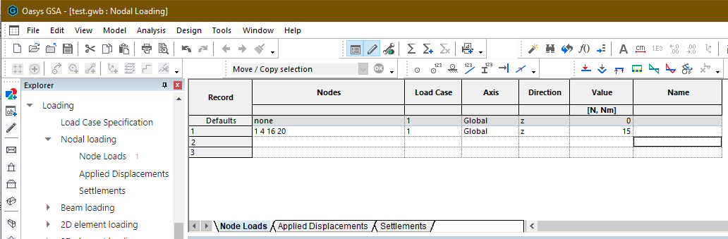
List of nodes in model to apply load to
Direction input: x, y, z, xx, yy, zz Default = z
Dropdown UI to change Load Type
Typical Loads – Node Load

Slide 45
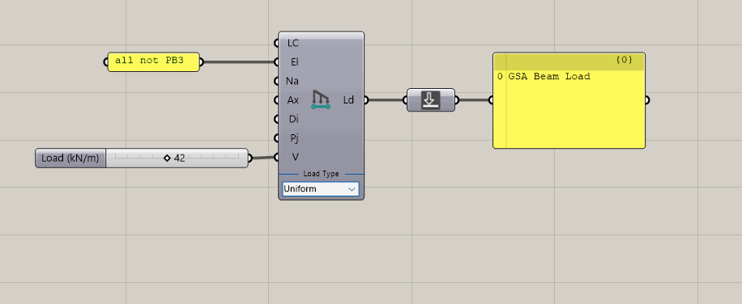
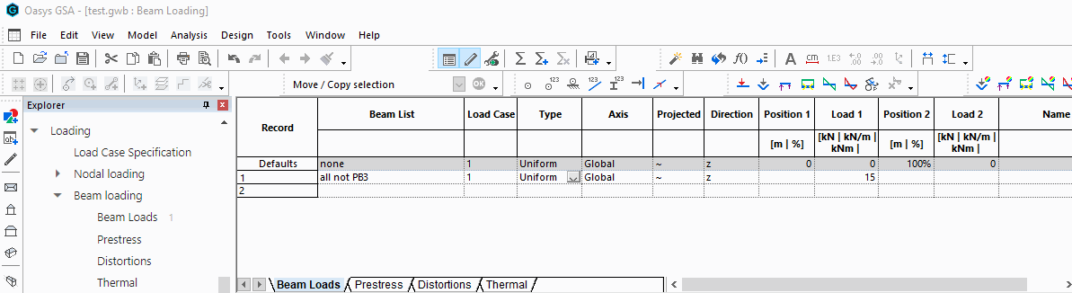
Axis: Global/Local - Default = Global
Direction: x, y, z, xx, yy, zz - Default = z
Projection: True/False - Default = False
Load Value and Position (t) adjusts with selected Load Type
Dropdown UI to change Load Type
Typical Loads – Beam Load

Slide 46
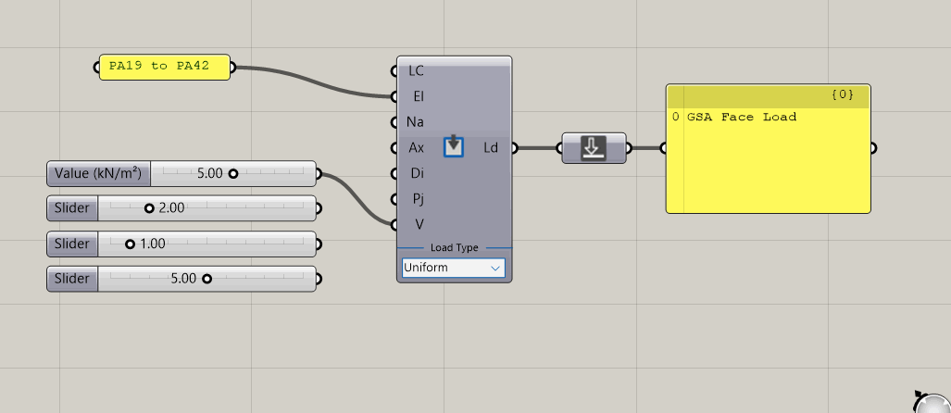
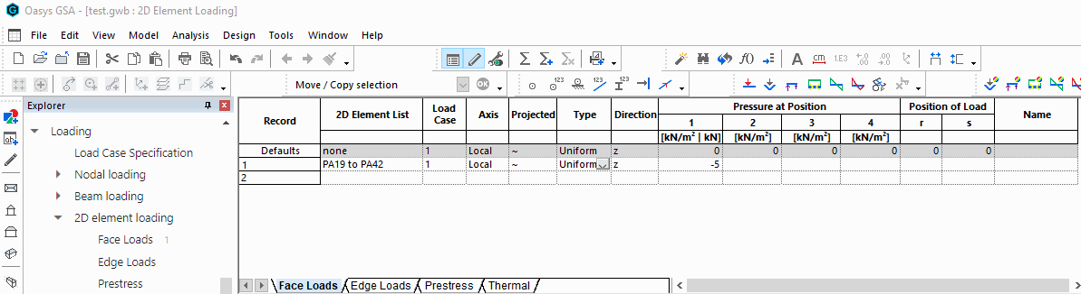
Axis: Global/Local - Default = Local
Direction: x, y, z, xx, yy, zz - Default = z
Projection: True/False - Default = False
Dropdown UI to change Load Type
Load Value and Position (t) adjusts with selected Load Type
Typical Loads – Face Load

Slide 47
Grid Loading
Automatically Expanded loads

Slide 48
Grid Loading - GridPlaneSurface

